Slide 1

CAP615 PROGRAMMING IN JAVA

Slide 2
Jagged array
type[][] arrayName = new type[rowCount][];
e.g:-int num[][]=new int[4][];
num[0]=new int[1];
num[1]=new int[2];
num[2]=new int[3];
num[3]=new int[4];

Slide 3
Enhanced for loop for 2D array
for (int[] num: arr)
{
for(int data: num)
{
System.out.println(data);
}
}

Slide 4
3 d array:
Syntax:
array_type[][][] array_name = new array_type[x][y][z];
Ex:
int[][][] num=new int[2][3][4];
Here, num[i][j][k] where ‘i’ is the array number, ‘j’ is the row number and ‘k’ is the column number.

Slide 5
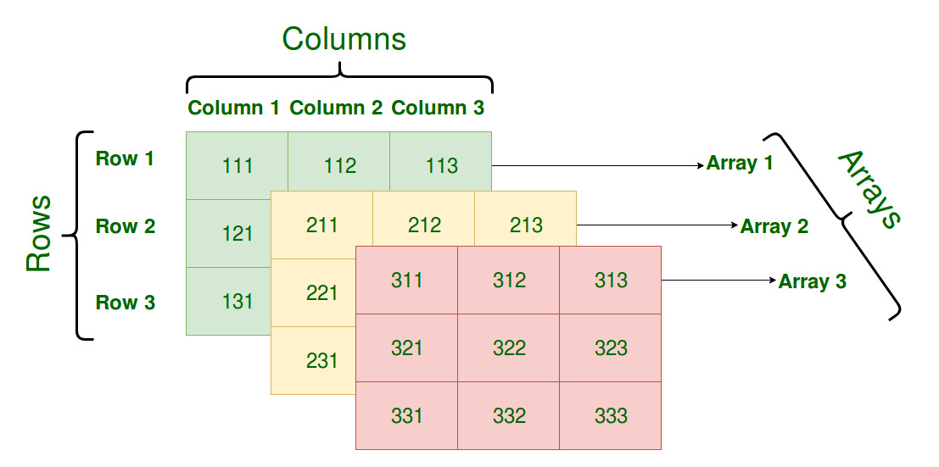
int[][][] num=new int[3][3][3];

Slide 6
For example find exam scores obtained by three students of each department in 3 different subjects.

Slide 7
Electronics department:
student1 scores: 75, 87, 69
student2 scores: 90, 87, 85
student3 scores: 56, 67, 76
Computer Science department:
student1 scores: 78, 67, 75
student2 scores: 87, 98, 76
student3 scores: 67, 56, 65
Information Technology department:
student1 scores: 72, 63, 72
student2 scores: 82, 91, 71
student3 scores: 64, 56, 66
To store all these exam scores, department-wise,
we will need to use three-dimensional array
int[ ][ ][ ] scores = new int[3][3][3];

Slide 8
4 D Array
Array of 3 D Array
int [][][][] num=new int[2][2][2][2];
Multi dimensional array means array of arrays.

